Slide 1
Input Data
General Code
Output Data
Dependency
Data Pipeline (pipeline.R)
Create Directories
Update Source Code
Run & Deploy App
Utility Functions (utils.R)
Load Packages
Common Functions
Connect to AWS S3
Outline Analysis Options
Raw Data (Blue Tracks Data)
Installation (installer.R)
Import (converter.R)
Numeric Data
Metadata
Categories, Subsets
Metadata
Rows: Samples
Columns: Features
Application
App Initialization (app.R)
App Functions (app_functions.R)
UI Functions (ui_functions.R)
Text / Dependencies (interface.R)
Interface Options (options.R)
Workflow
Numeric Data
Rows: Samples
Columns: Features
Dimensionality Reduction
PCA (reduction_pca.R)
VAE: (reduction_vae.R)
UMAP (reduction_umap.R)
PHATE: (reduction_phate.R)
Sets: (reduction_sets.R)
Preprocessing (scaling.R)
Scaling
Logarithmic
Linear
Normalization
Global Min Max
Local Min Max
Global Z-Score
Local Z-Score
Quartile
Features
100%
10%
1%
Data Retrieval
If Bookmark, Import Session
Connect to Local / AWS
Read User Inputs
Retrieve & Load Data
Visualize (Explore, Summarize, tSNE)
PCA (visualize_pca.R)
VAE (visualize_vae.R)
UMAP (visualize_umap.R)
PHATE: No Other Processing
Sets: No Other Processing
Filtering
Calculate Metadata Filters
Apply Filters Cumulatively
Subset Table Rows
Colors, Shapes, Labels
Storage: Local / AWS (packaging.R)
Load Visualization Data
Compartmentalize Tables
Create Keys (folders, file names)
Save to Folder / Bucket
Plotting
ggplot2 (UpSetR for Sets)
plotly2 (Heatmap for Sets)
plotly3 (Heatmap for Sets)

Slide 2
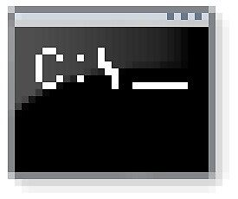

Input Data
General Code
Output Data
Dependency
Project Setup
Workflow
Application
Installation: install.R
Common Functions
Find Environment
Install Packages
Set Project Root
Numeric Data (Tabular)
Rows: Samples
Columns: Features
Metadata (Tabular)
Rows: Samples
Columns: Features
Preprocessing: preprocess.R
Row / Sample Subsets
Column / Feature Subsets
Scaling [Log2, Linear]
Normalization [Global Min Max, Local Min Max, Global Z-Score, Local Z-Score, Quartile]
App Initialization: app.R
Access: authentication.R
UI Functions: ui_functions.R
Interface Options: options.R
Connect Storage: storage.R
Workflows: workflows.R
Store Workflow Roots
Create Directories
Update Source Code
Run & Deploy App
Postprocessing
Import Reduced Datasets
Calculate Metadata Filters
Colors, Shapes, Labels
Apply User Parameters
Utility Functions: utils.R
Load Packages
Common Functions
Connect to AWS S3
Set Analysis Options
Reduction: red_methods.R
PCA [10D, Summary, tSNE]
VAE [10D, Summary, tSNE]
UMAP [10D, Summary, tSNE]
PHATE [2D, 3D]
Thresholding Sets [UpSetR]
Plotting: plotting.R
Static 2D: ggplot2
Interactive: plotly
Boxplots: beeswarm
Heatmaps: heatmaply
Intersections: VennDiagram
Data Tables: DT
Import Data: converter.R
Citations, Credentials
Datasets [Categories]
Row / Column Subsets
Numeric Data
Metadata
Local / AWS Storage: packaging.R
Load Visualization Data
Compartmentalize Tables
Create Keys (folders, file names)
Save to Folder / Bucket

Slide 3
authentication.R*: Manages user authentication for the application.
install.R*: Validates working directory / configuration, declares utility functions, installs packages.
converter.R*: Standardizes data for downstream processing and generates app configuration files.
bcrypt
find_replace.R*: Declares functions for finding / replacing fixed / regex expressions in text.
shiny, dplyr, BiocManager
storage.R*: Declares functions to list, find, read, and write files on operating systems / AWS.
validation.R*: Validates numeric data tables.
stringi
aws.s3
workflows.R*: Manage folders & app deployment for each workflow.
text_work.R*: Makes functions for identifying bookmarkable elements, manipulating menu text.
red_methods.R*: Implements PCA, VAE, UMAP, PHATE, Sets, and tSNE as reduction methods.
preprocess.R*: Names and initializes reduction parameters. Names, stores, and loads files.
reticulate, hash, tensorflow, keras, phateR, umap, Rtsne, Matrix
ui_functions.R*: Makes functions that generate interactive HTML widgets for Shiny applications.
red_requests.R*: Declares functions for efficiently performing and storing reduction requests.
make_requests.R*: Loads stored category / subset data. Declares functions for validating, creating, combining, and identifying reduction requests.
shinycssloaders, shinywidgets
sca_nor_fun.R*: Declares scaling / normalization functions.
options.R: Tests storage systems, generates menus, and assembles user interfaces for the application.
limma
packaging.R: Assembles a broad set of reduction requests, executes them, and syncs data to AWS.
plotting.R*: Makes visualizations (plots, tables) for the application.
shinyjs, shinydashboard
*Has unit tests.
viridis, ggplot2, plotly, beeswarm, DT, UpSetR, VennDiagram, heatmaply
app.R: Makes an interactive Shiny application capable of visualizing dimensionally reduced data.
Notes:
OLD

Slide 4
install.R
preprocess.R
workflows.R
make_requests.R
red_methods.R
app_utils.R
transforms.R
storage.R
dashboard.R
red_requests.R
plotting.R
converter.R
app.R
Notes:
NEW

Slide 5
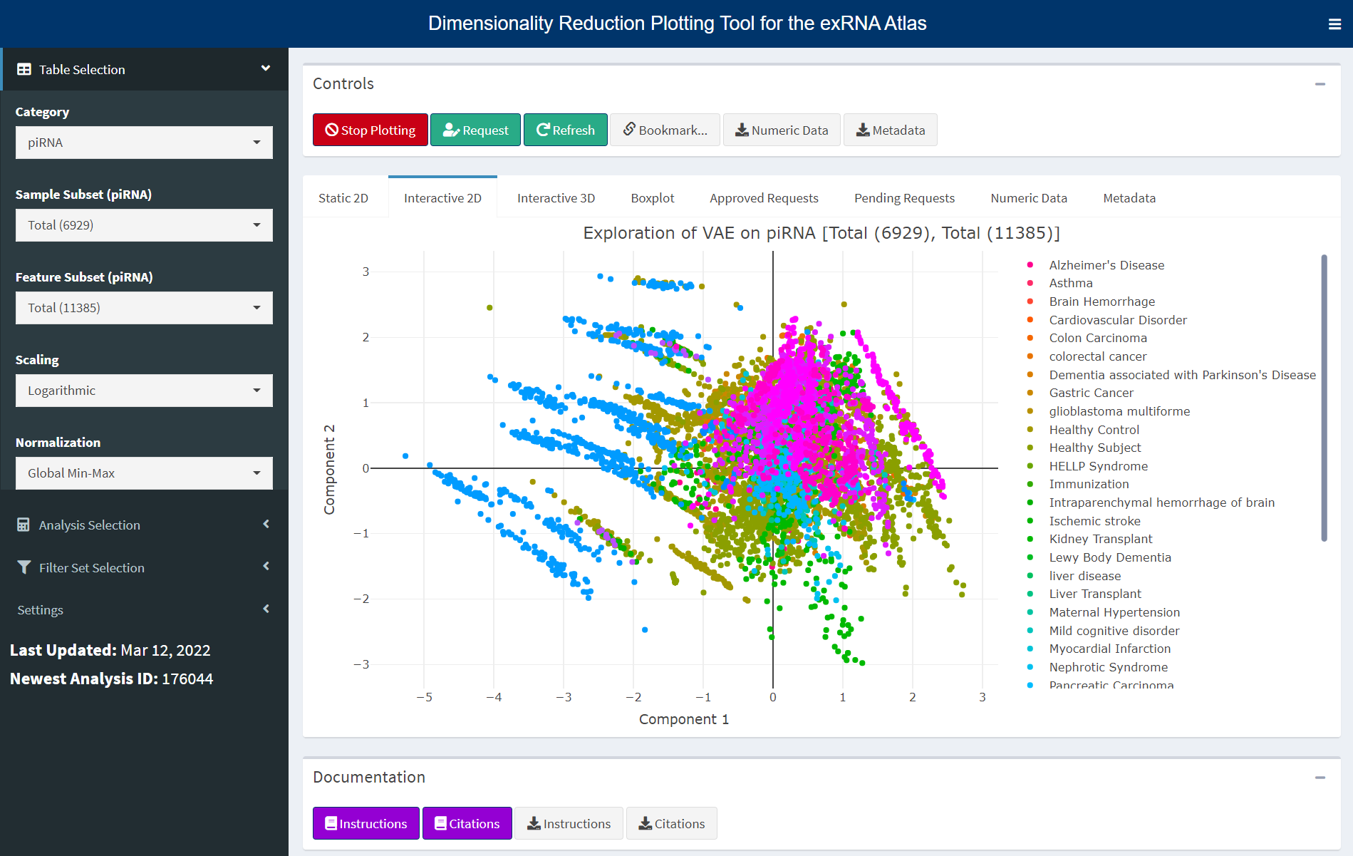
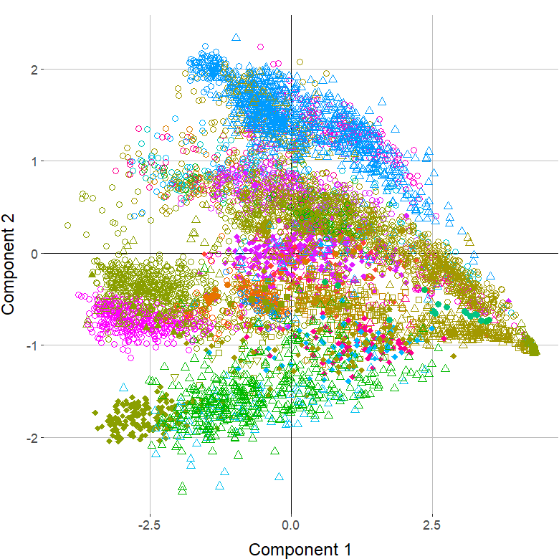
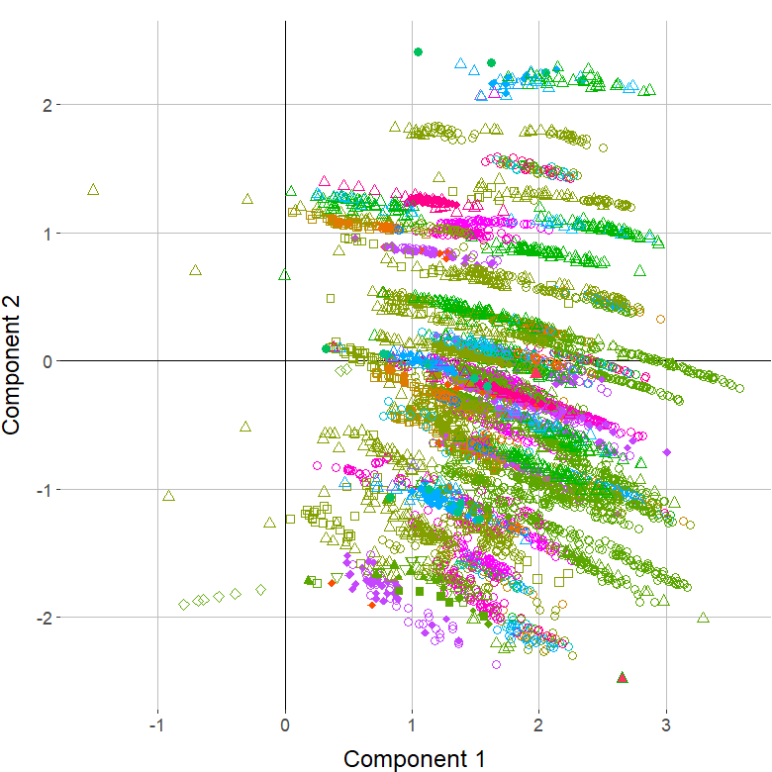
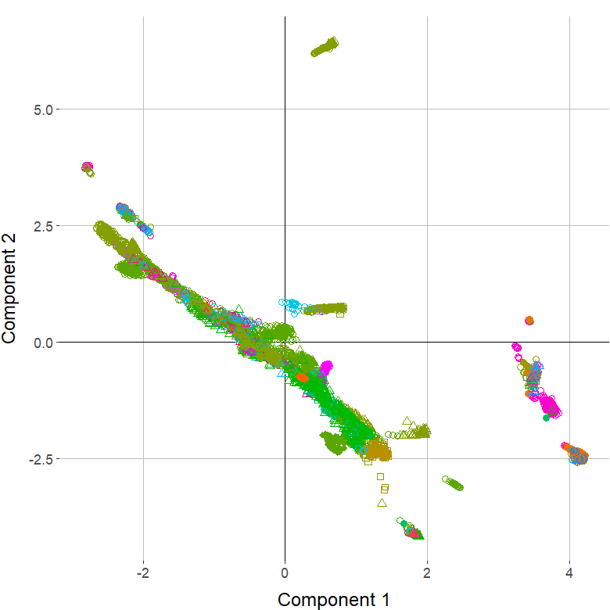
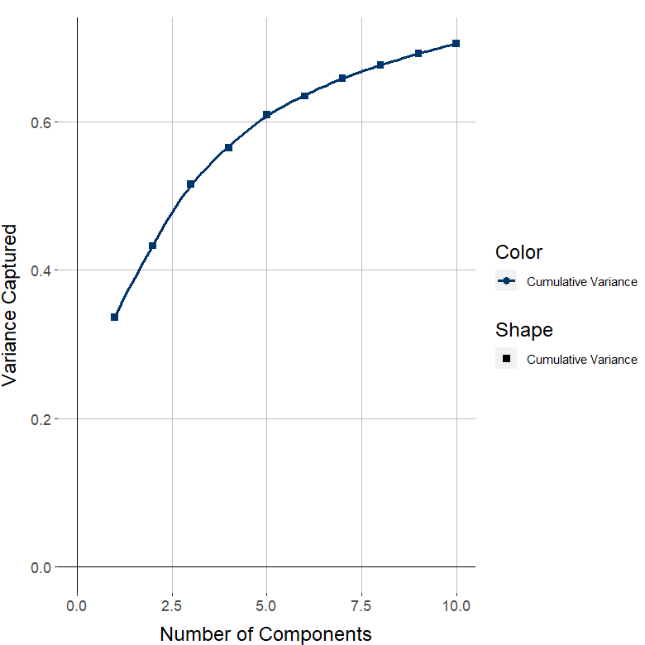
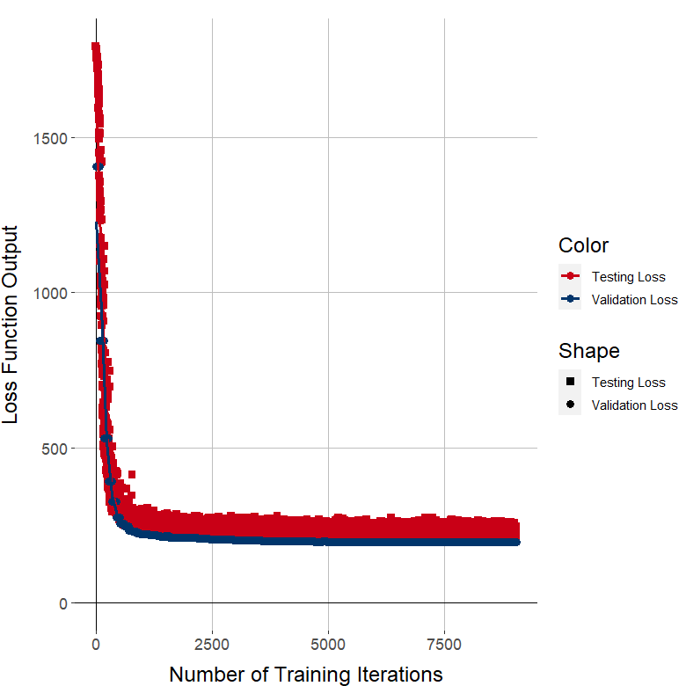
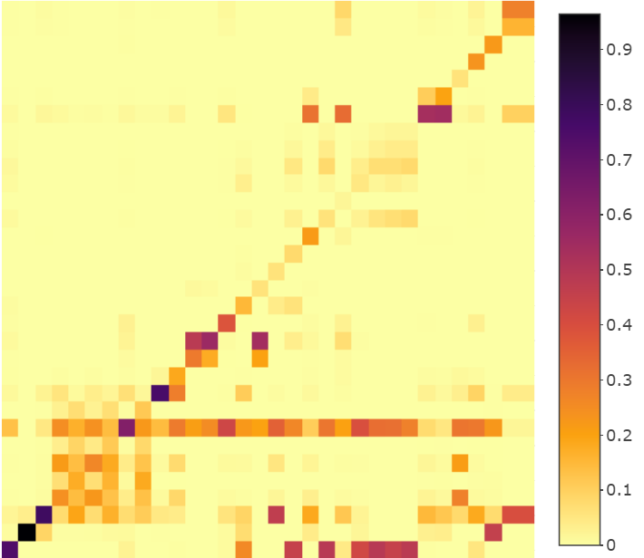
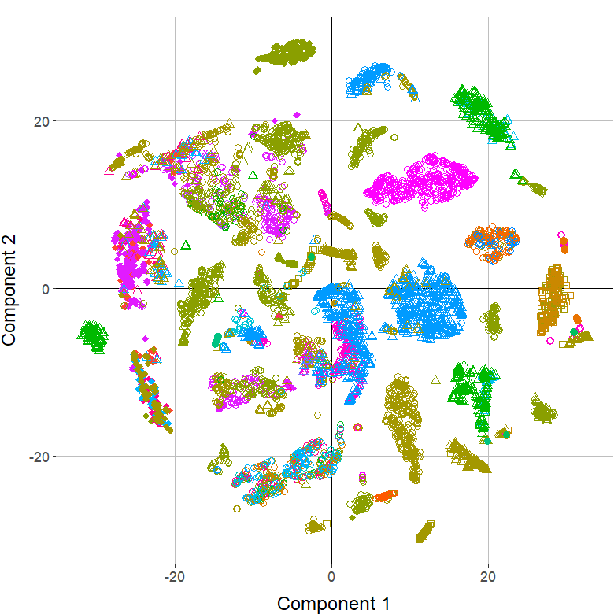
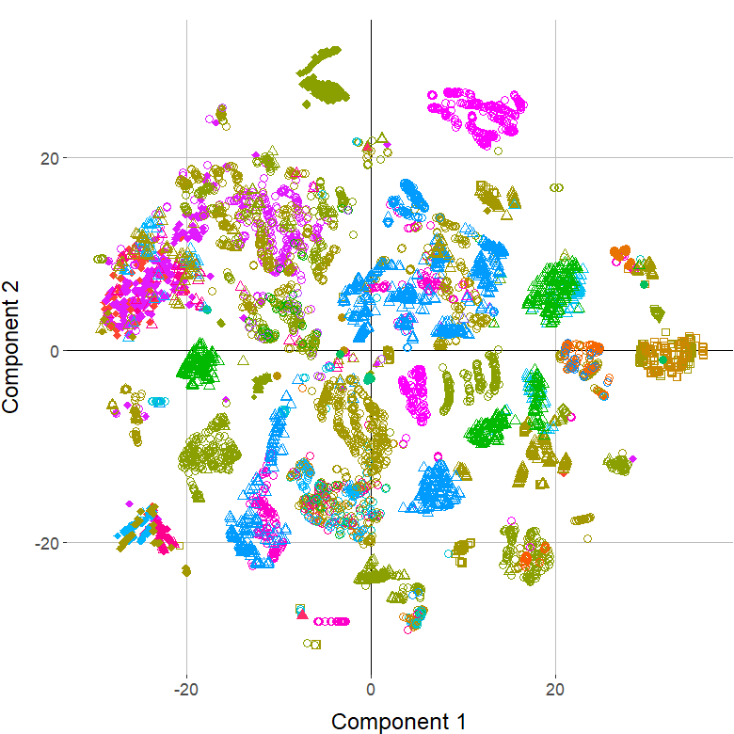
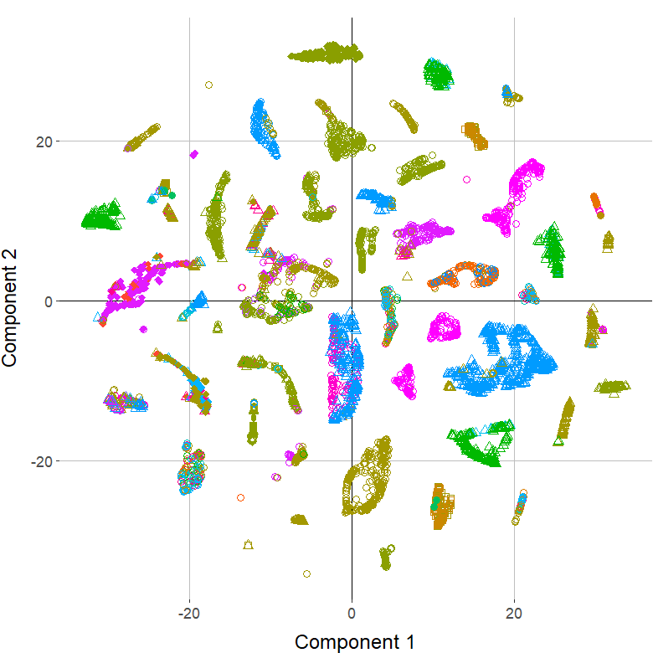
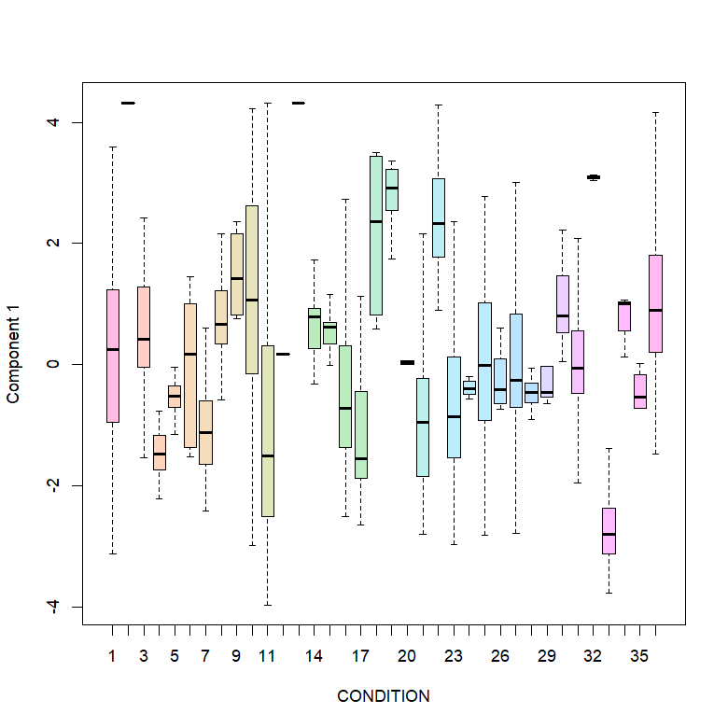
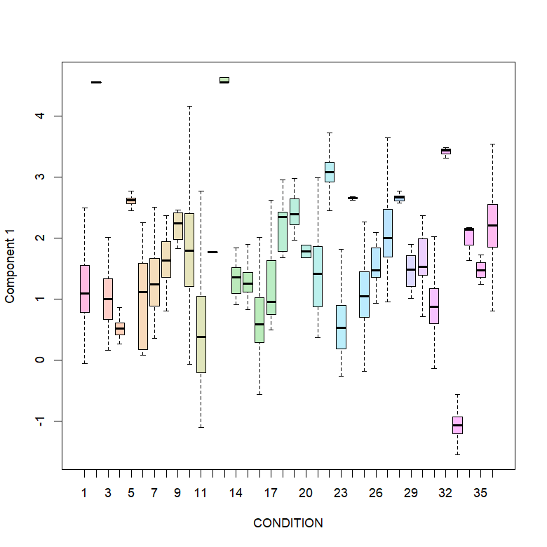
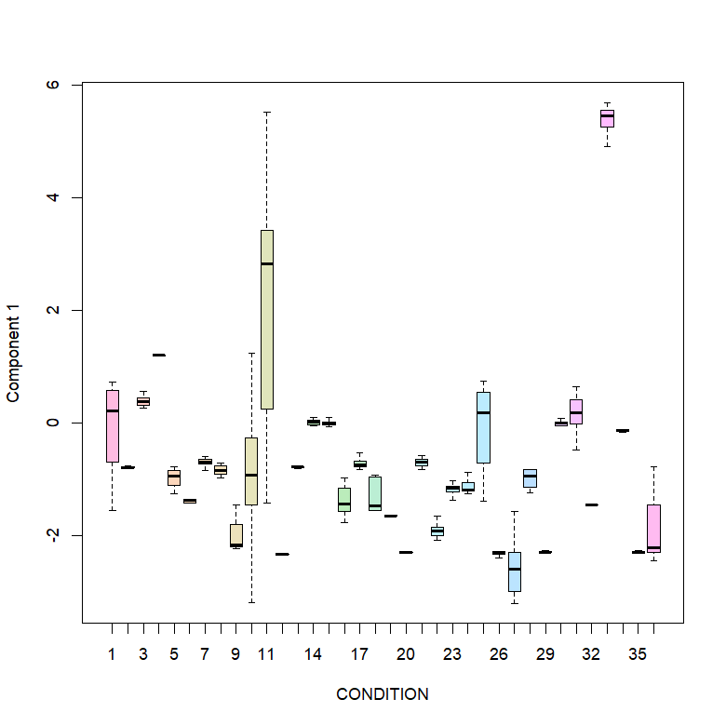
PCA
VAE
UMAP
Embedded Components
Reduction Statistics
tSNE After
Reduction
Analysis Settings
Custom Analyses
Grouped Boxplot
Plot Settings
Data Downloads

Slide 6
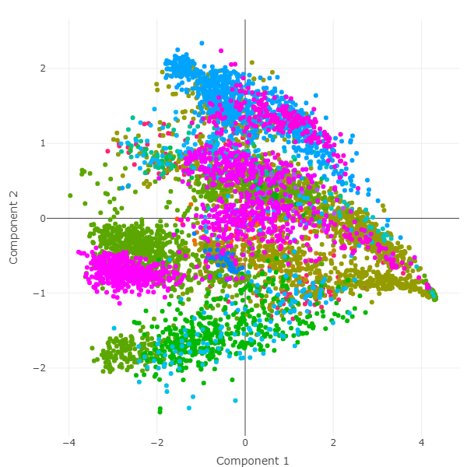
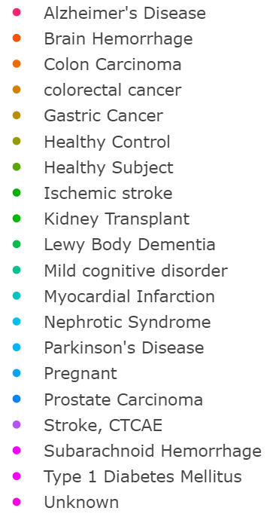
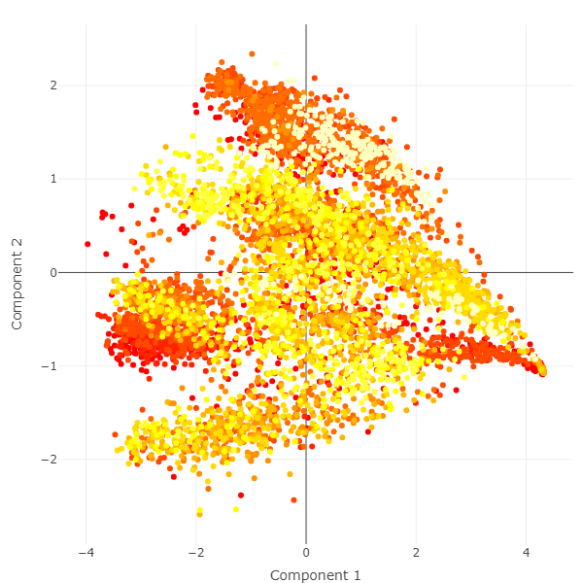
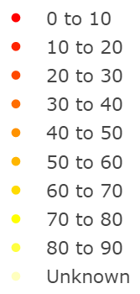
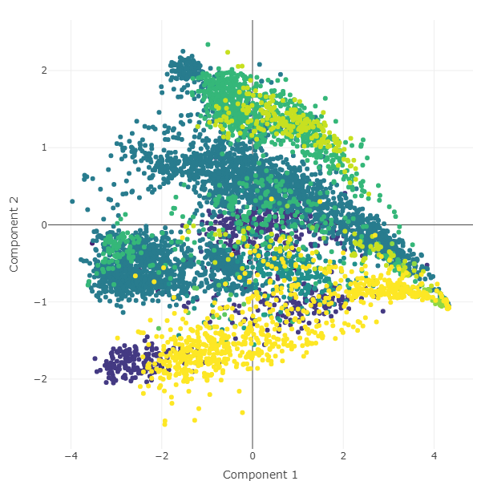
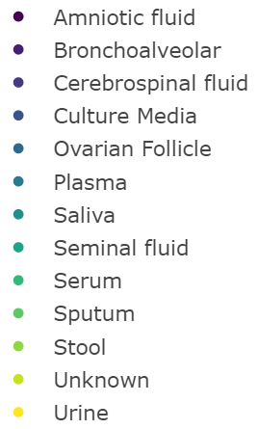
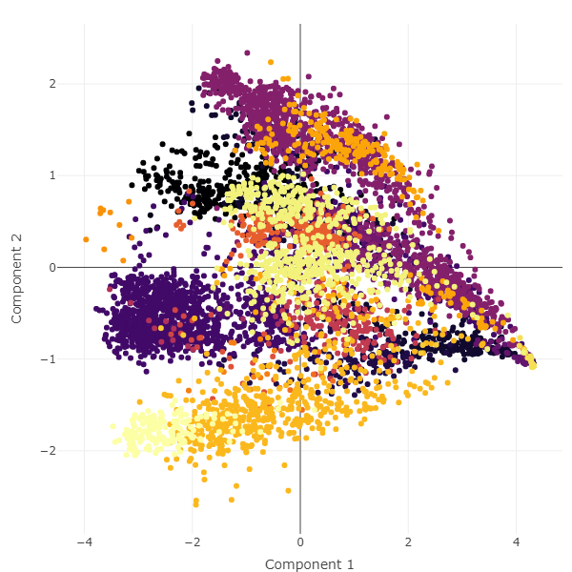
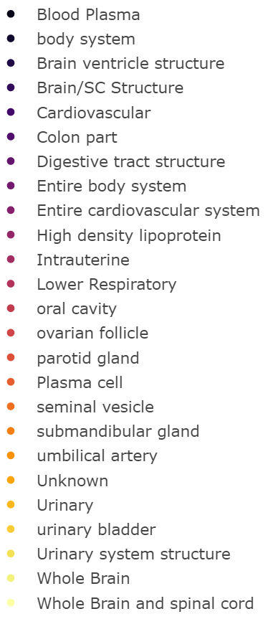
Label by Disease State
Label by Age Group
A
B
Label by Biofluid
Label by Tissue
C
D

Slide 7
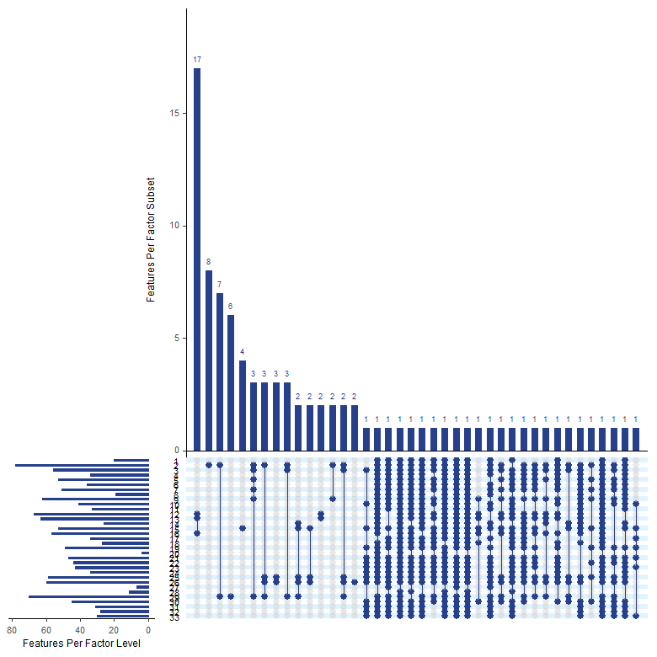
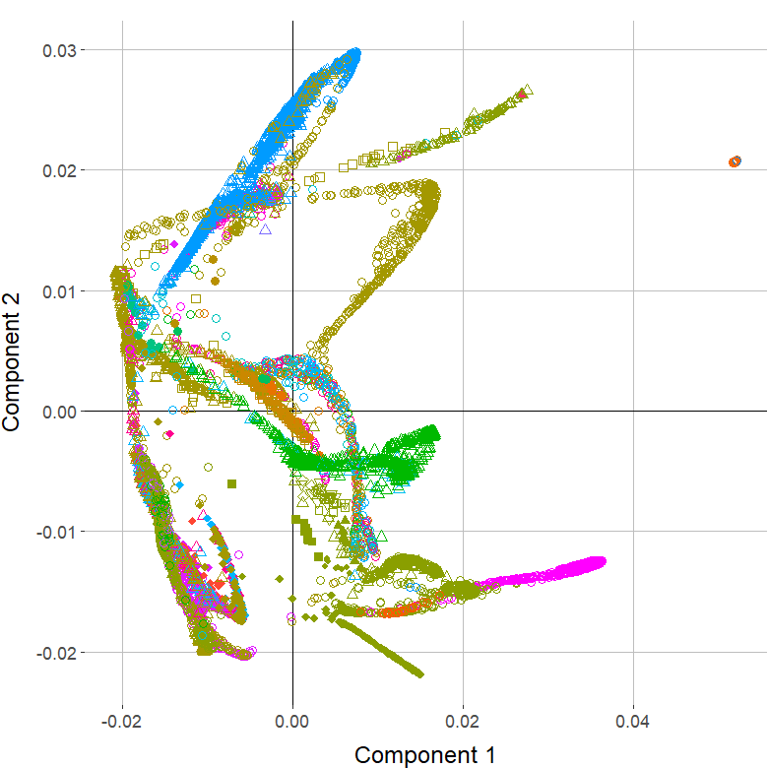
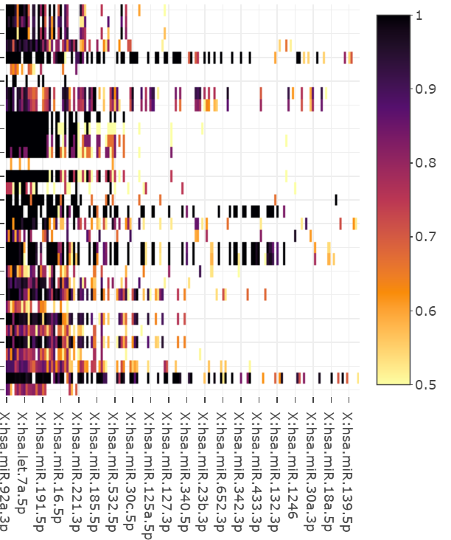
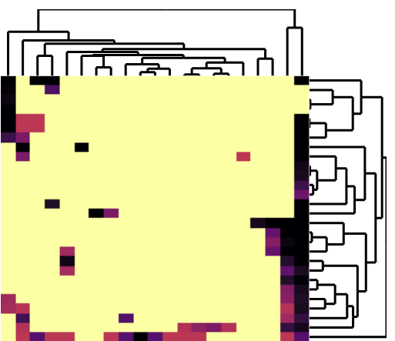
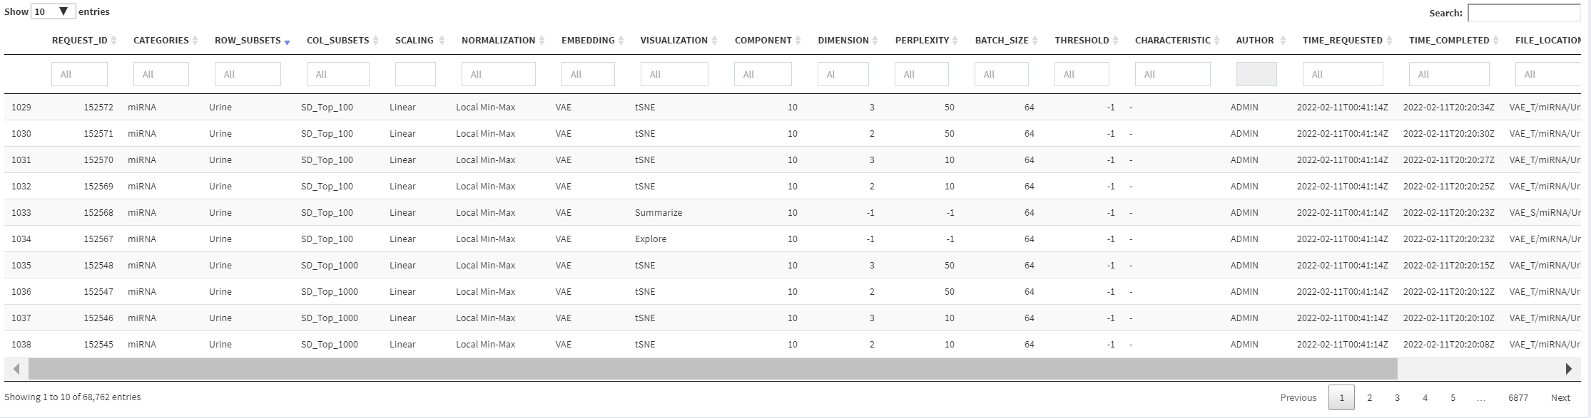
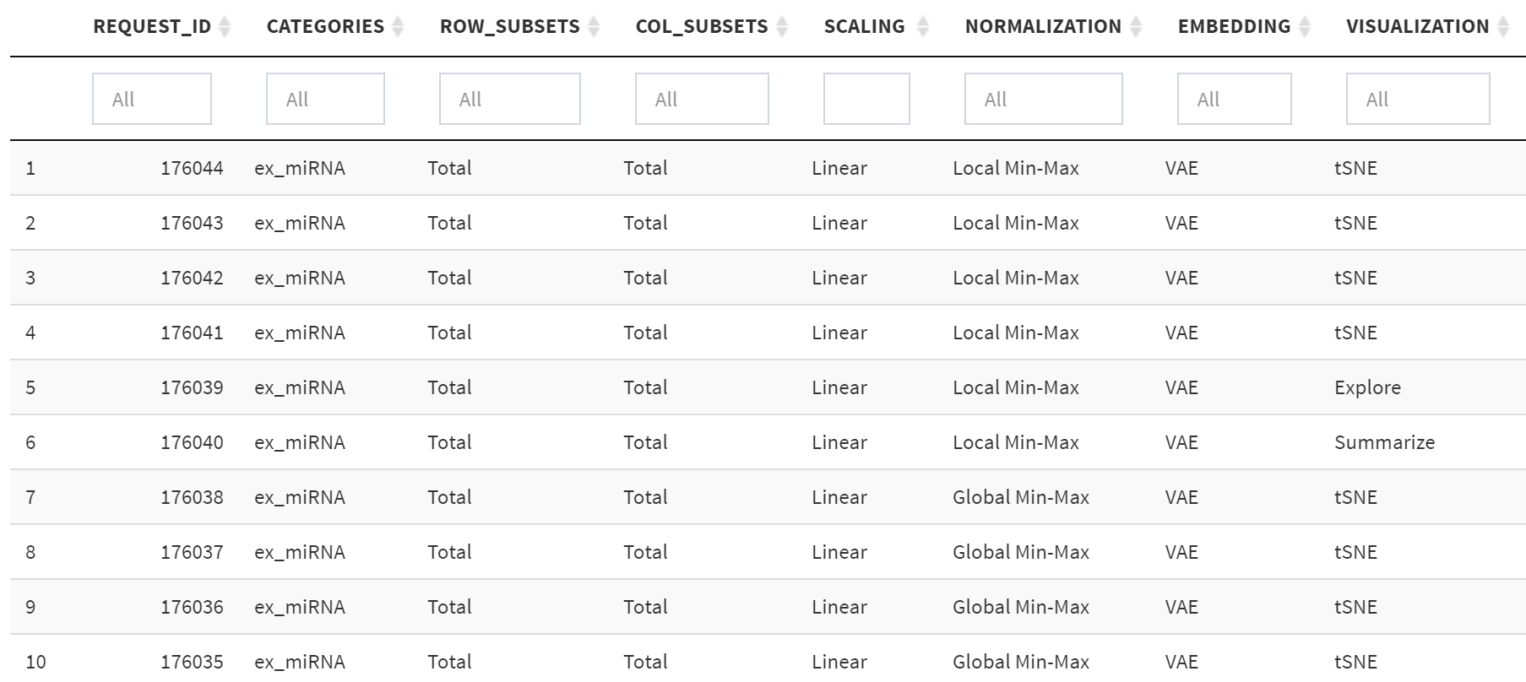
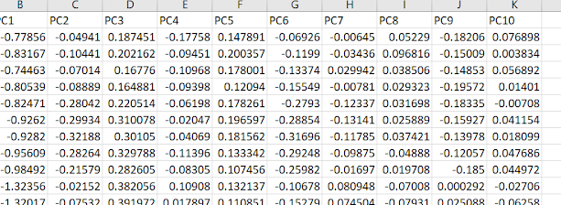
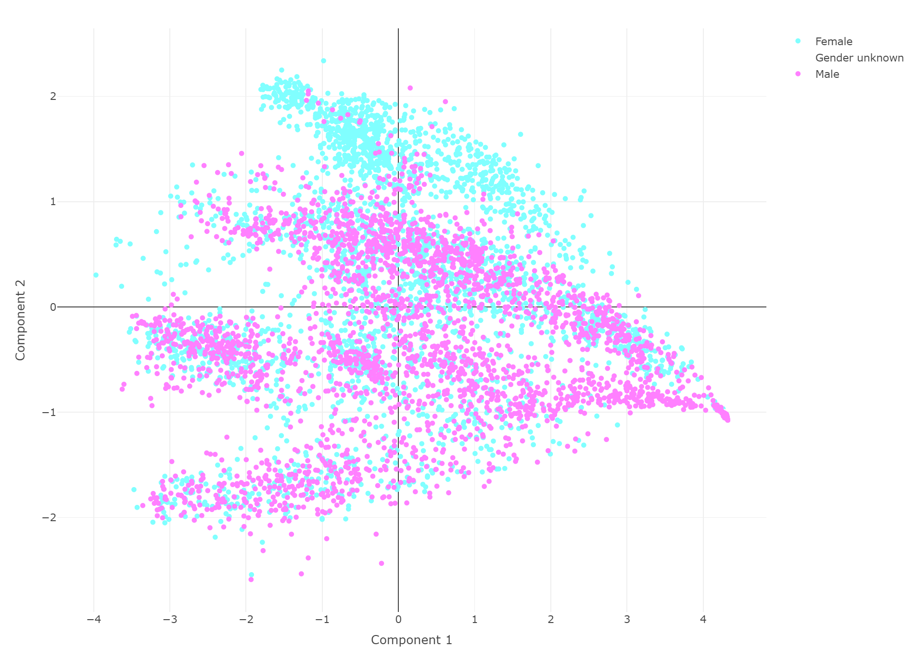
Supplemental Figure for Custom Analyses
Pipeline: Data → Subsets → Scaling → Normalization → Reduction → Plotting

Slide 8
Old Architecture
User
Repo
Server
Pipeline
Interpreter
Pipeline Code (R, Python, C++)
App Code
AWS S3
exRNA Workflow
exRNA Local App
exRNA Cloud App
exRNA
Cloud Store
exRNA
Local Store
App Data 1
Interpreter
App
Code
App Data 1
App Data 2, …
App Code
App Data 2, …
EN-TEx Workflow
EN-TEx Local App
EN-TEx Cloud App
EN-TEx
Cloud Store
EN-TEx Local Store
App Data 1
Interpreter
App
Code
App Data 1
App Data 2, …
App Code
App Data 2, …
MNIST Workflow
MNIST Local App
MNIST Cloud App
MNIST
Cloud Store
MNIST
Local Store
App Data 1
Interpreter
App
Code
App Data 1
App Data 2, …
App Code
App Data 2, …

Slide 9
New Architecture
AWS S3
User
Server
Project Repository
exRNA Cloud App
exRNA Cloud Store
exRNA Local Store
App Data
App Data
App
Code
App Data
Application
EN-TEx Cloud App
EN-TEx Cloud Store
App Data
App Data
App
Code
EN-TEx Local Storage
App Data
App Data
MNIST Cloud App
MNIST Cloud Store
MNIST Local Store
Pipeline
App Data
App
Code
App Data
App Data

Slide 10
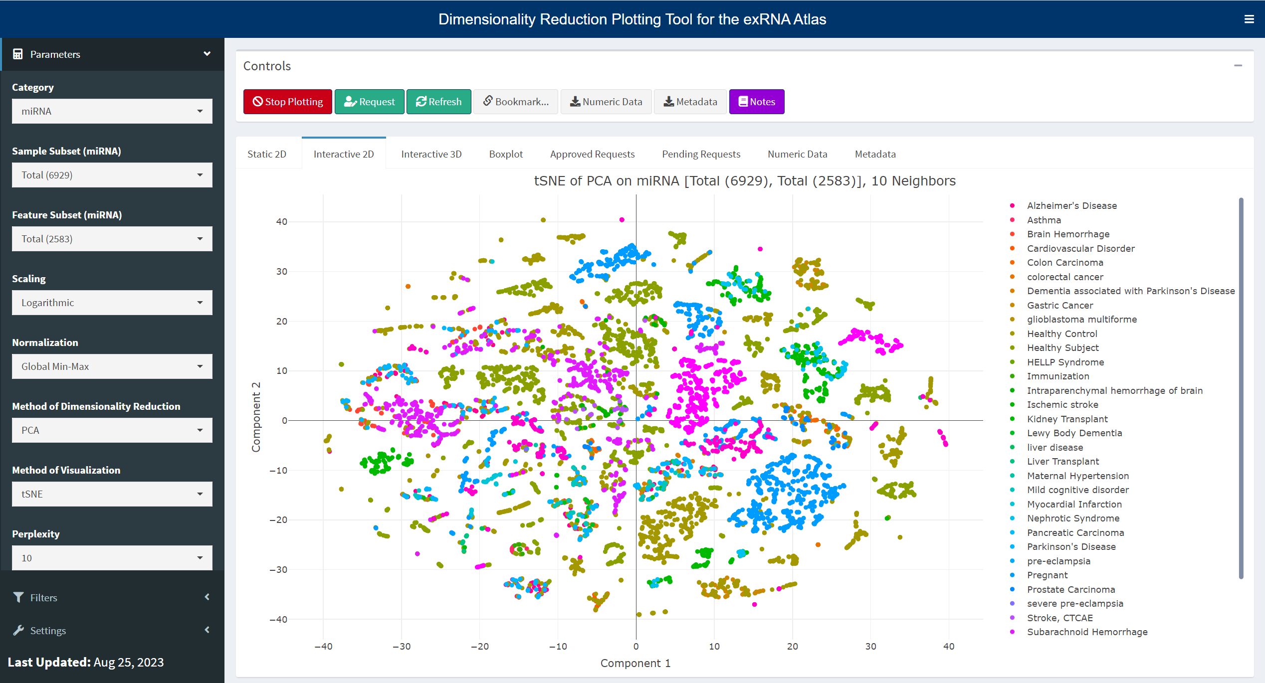
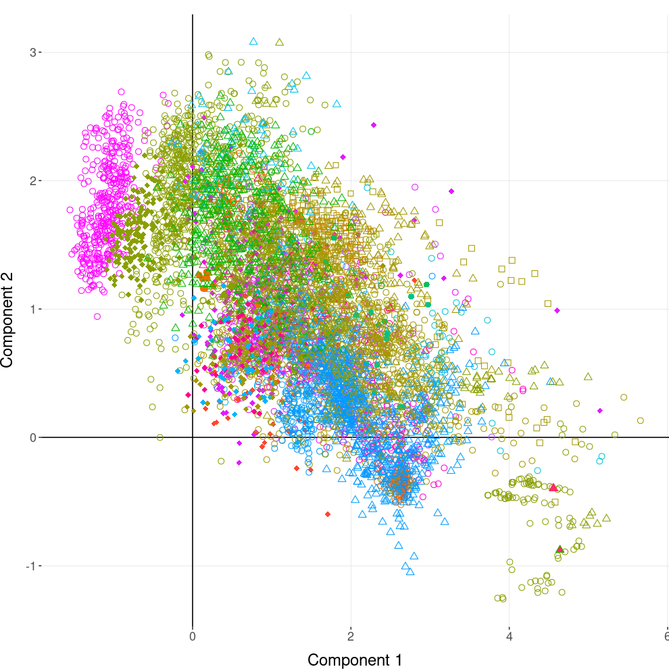
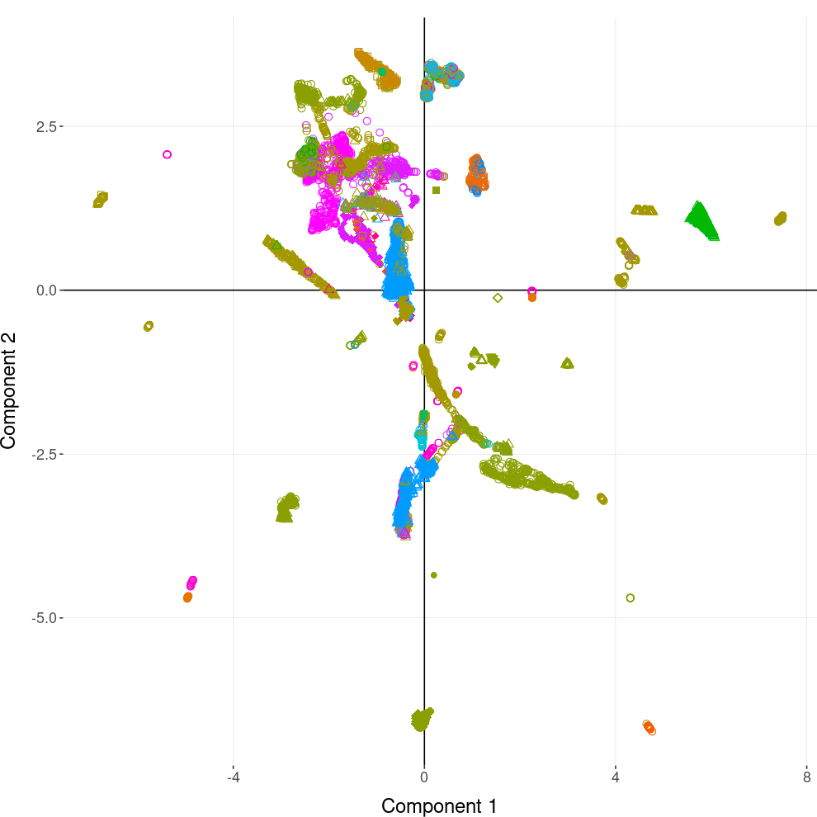
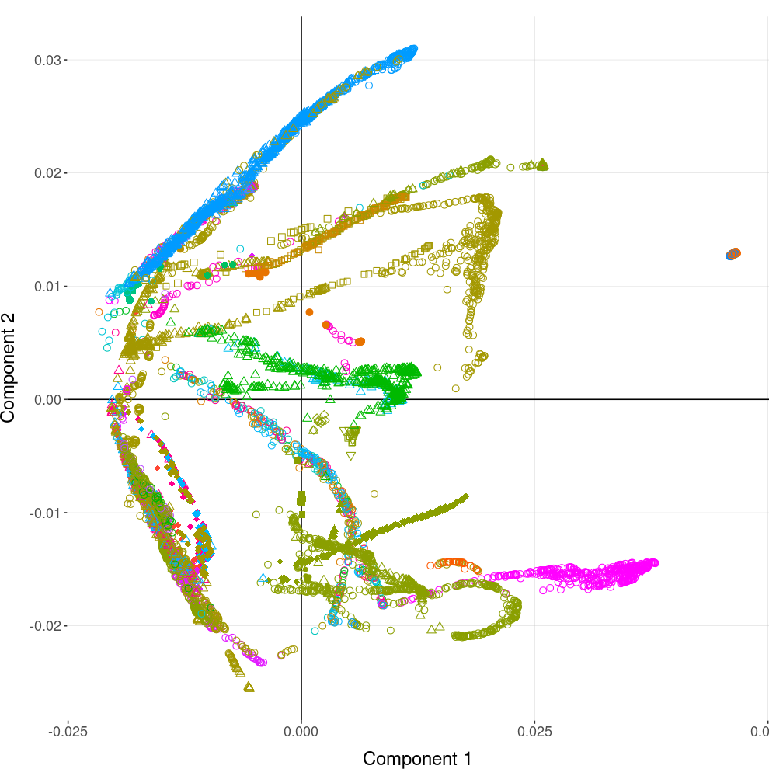
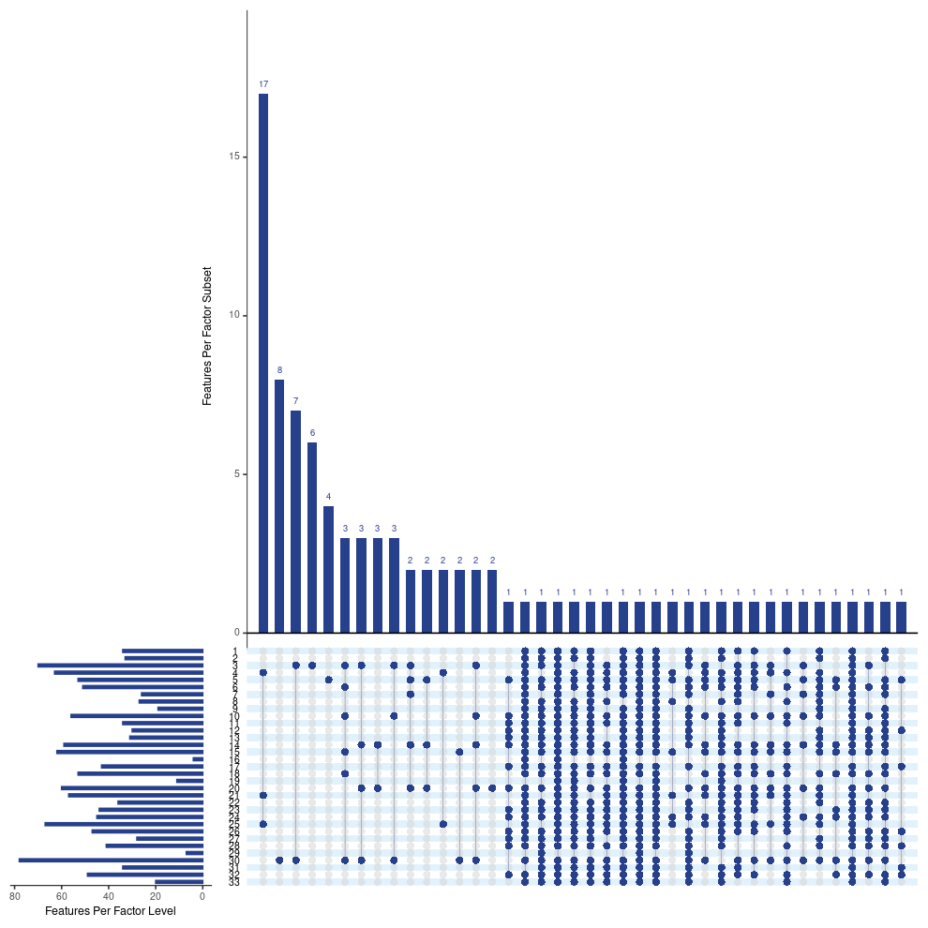
New Architecture
PCA + tSNE
MNIST Local Storage
MNIST Cloud Storage
MNIST Local App
MNIST Cloud App
exRNA Local Storage
exRNA Cloud Storage
exRNA Local App
exRNA Cloud App
EN-TEx Local Storage
EN-TEx Cloud Storage
VAE
UMAP
PHATE
Sets
EN-TEx Local App
EN-TEx Cloud App
…
…
Local
Cloud
exRNA Explorer Tool (miRNA)

